Slide 1
Advanced .Net Final Presentation
Dhruv Moradiya
- Divya Vedant
- Sai Vikas Mandadi
- Shiva Krishna Chenna

Slide 2
Presentation Flow
The Problem
Challenges Involved
Our Solutions
Limitations
Conclusion

Slide 3
Problem
Creating a Movie Theatre Application for MoviePlex Theatre (a company known worldwide for having no line-ups or delays when purchasing movie tickets). Part of their success comes from the fact that their business is automated and no human intervention is needed for any of their business processes. MoviePlex Theatres now wants to fully automate their ticket selling system and your team has been contracted to develop the system and provide a world-class experience for its users.

Slide 4
Challenges Involved
Identifying the flow of steps
Using Array to store the data
Testing the flow
Validations

Slide 5
Solutions
Went through the requirements clearly to determine the flow of implementation.
Used the C# features like for loop, while, if else, switch case to ease out the complexities.
Did the testing after each implementing each unit level functionality and modified the logic to failed test cases.
Included validation scenarios to ensure the smooth flow for the process without breakage of code.

Slide 6
Limitations
The current implementation is developed on basis of arrays to hold the data , we didn't support it with session or cache level mechanism.
It don’t have the User interface to interact, it's a console level application.
Its a pure C# code, it doesn't have MVC architecture implemented.

Slide 7
Working Of The Application

Slide 8
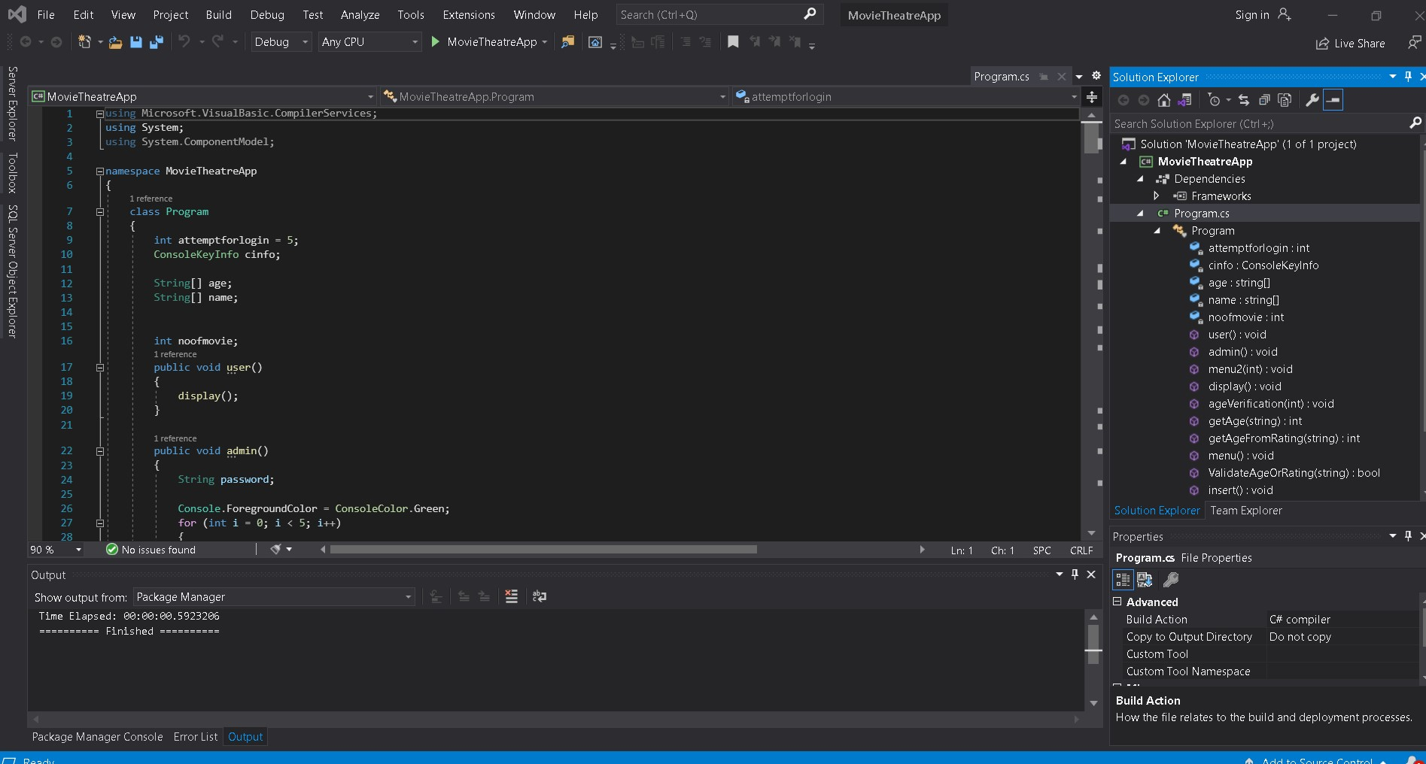

Slide 9
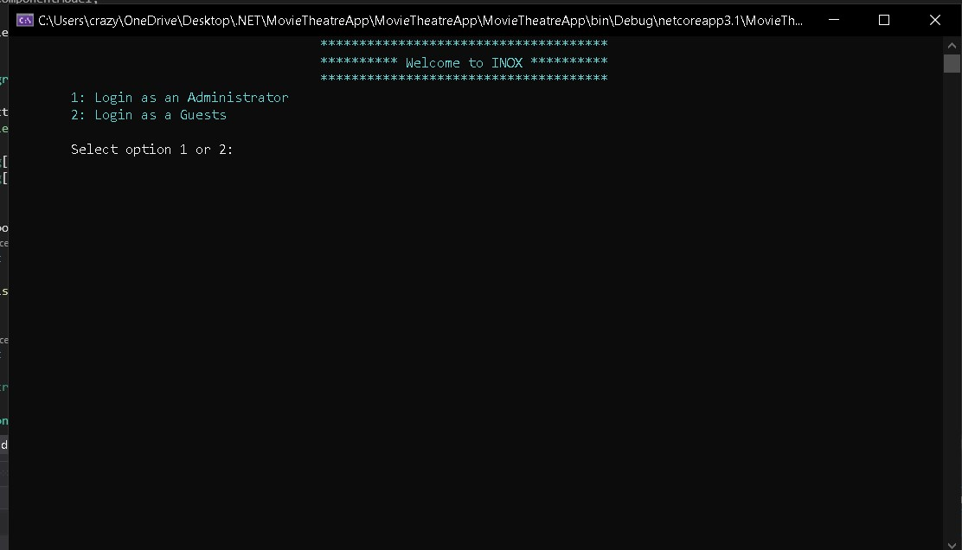

Slide 10
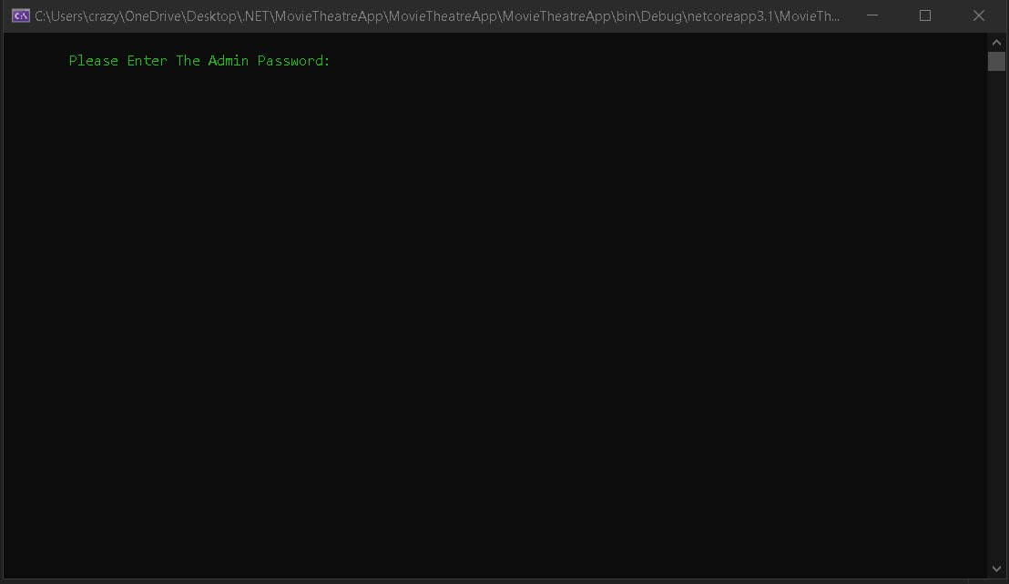

Slide 11
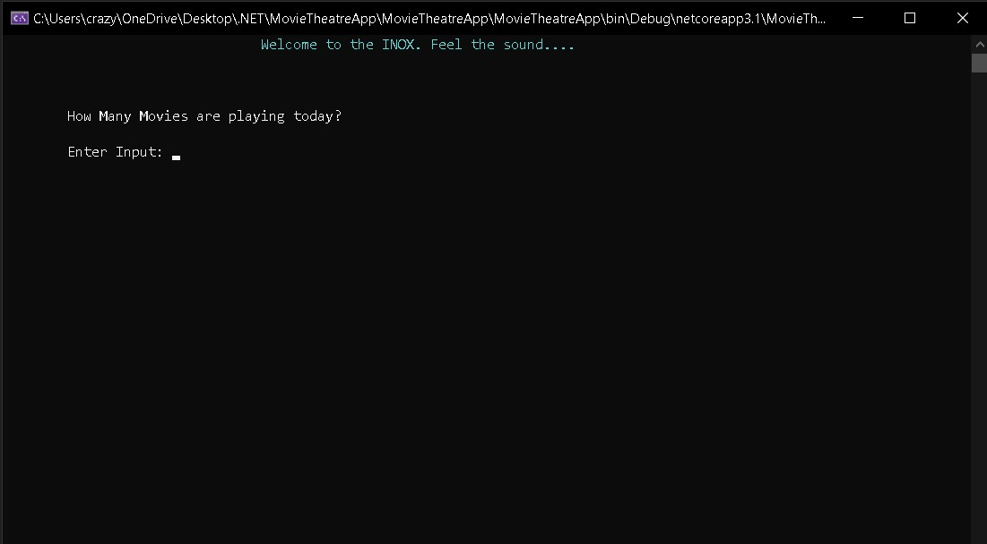

Slide 12
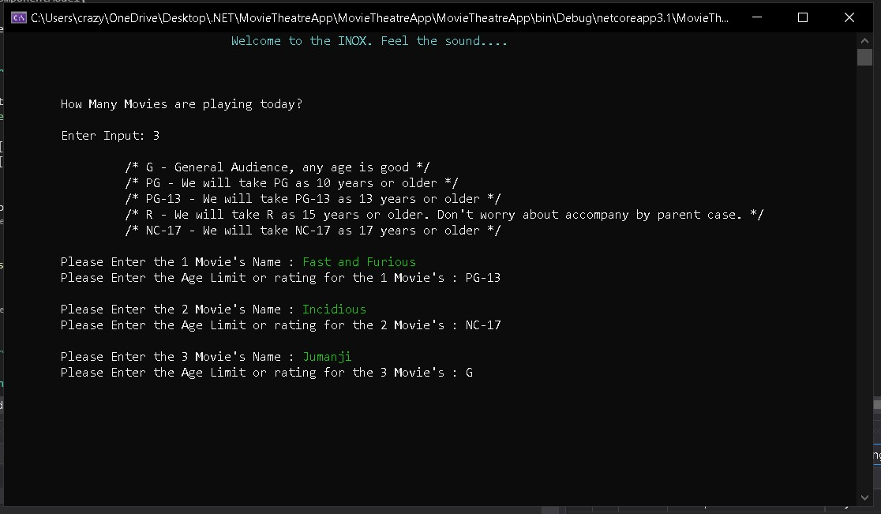

Slide 13
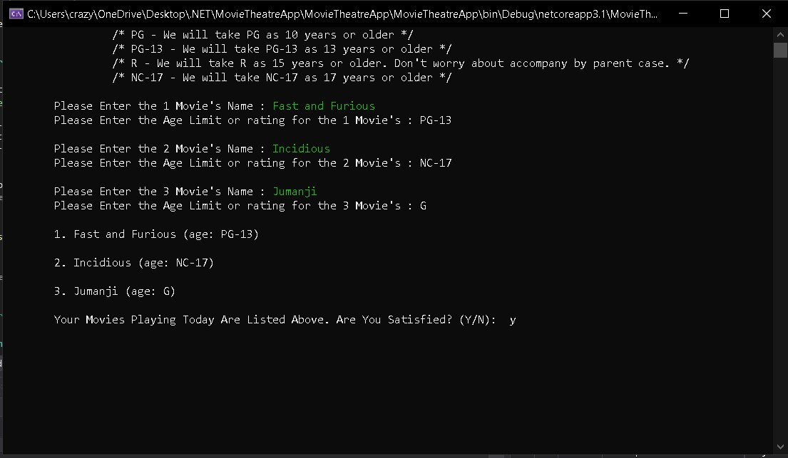

Slide 14
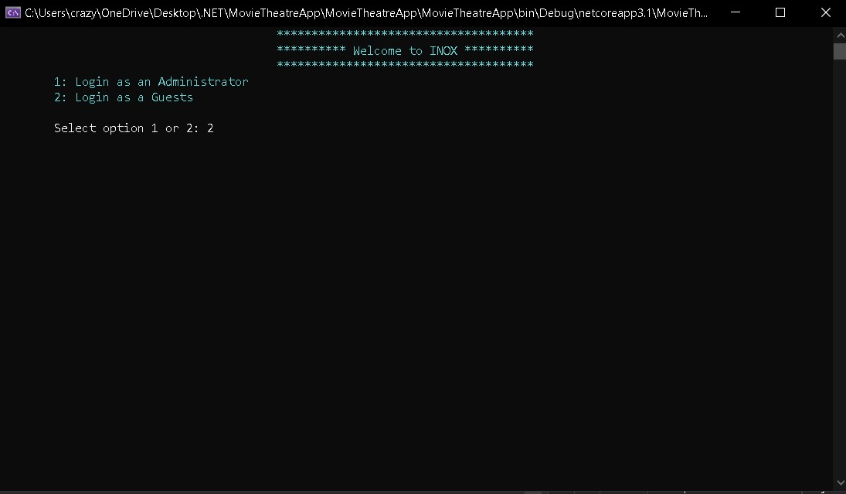

Slide 15
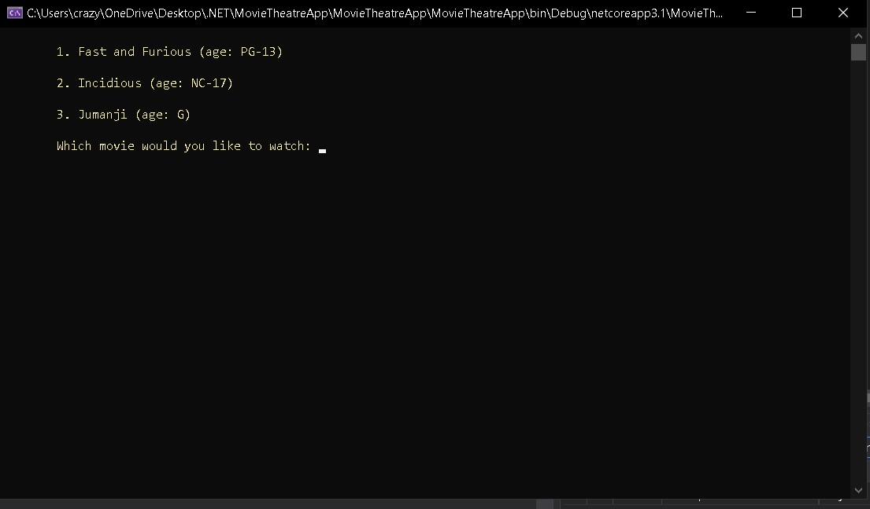

Slide 16
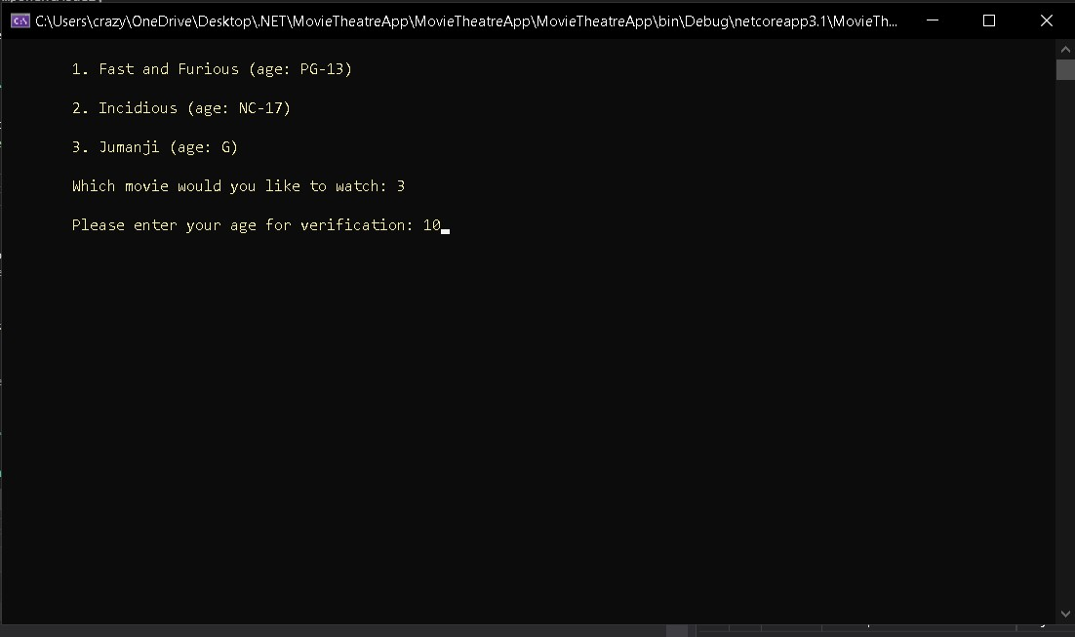

Slide 17
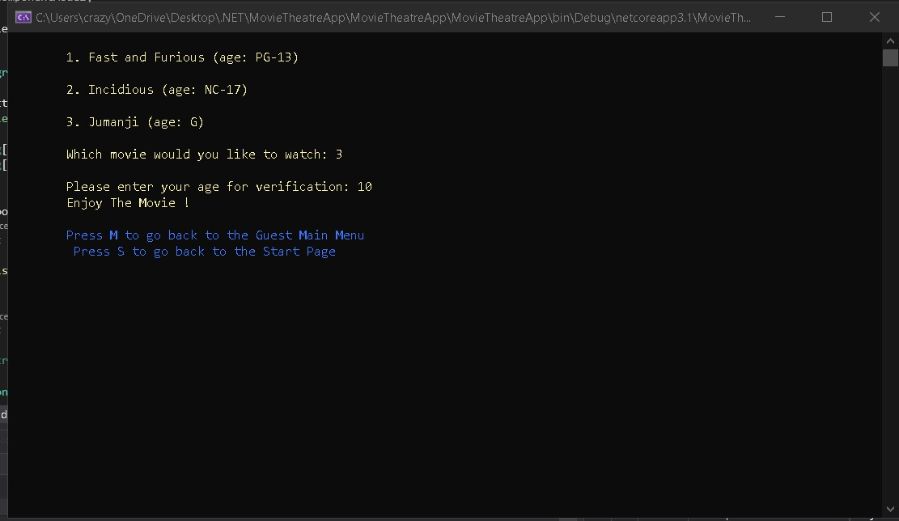

Slide 18
Validations

Slide 19
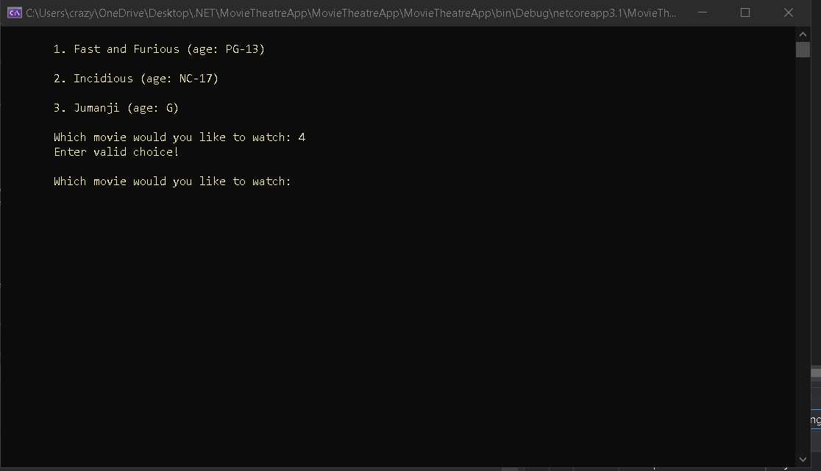

Slide 20
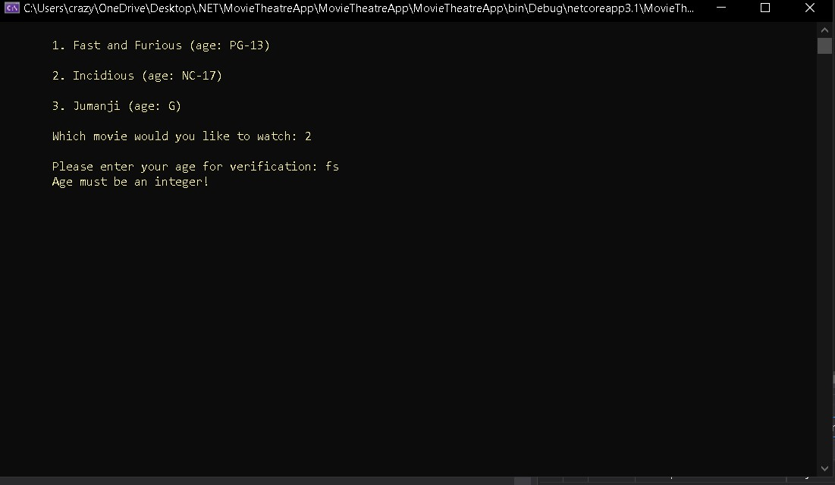

Slide 21
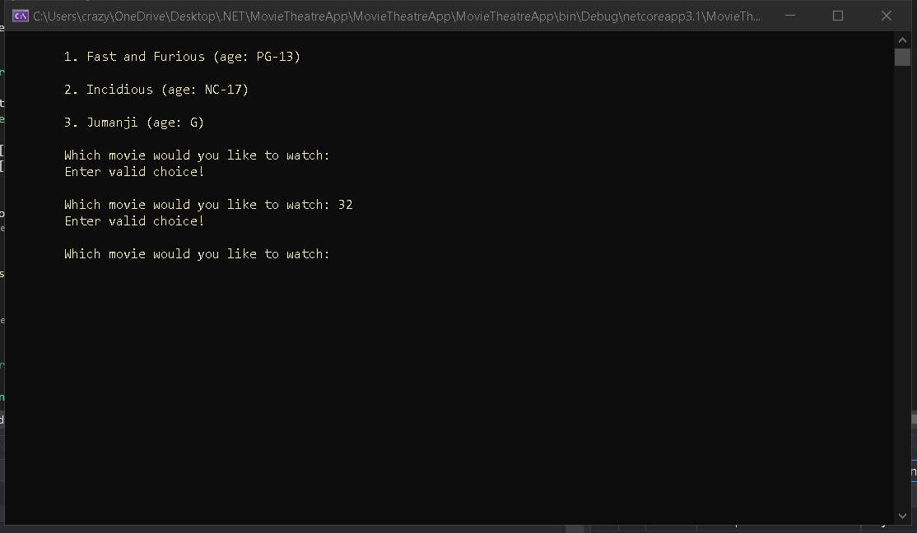

Slide 22
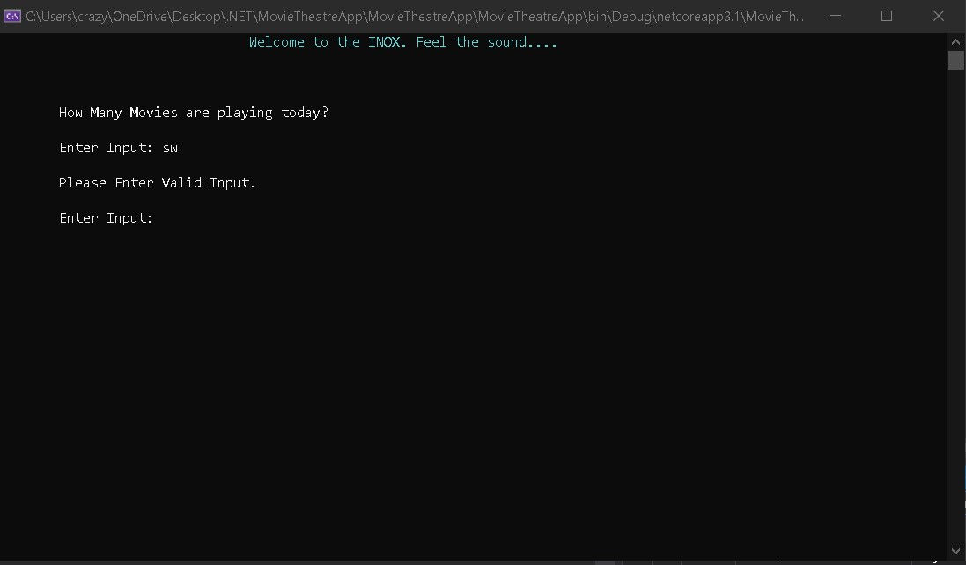

Slide 23
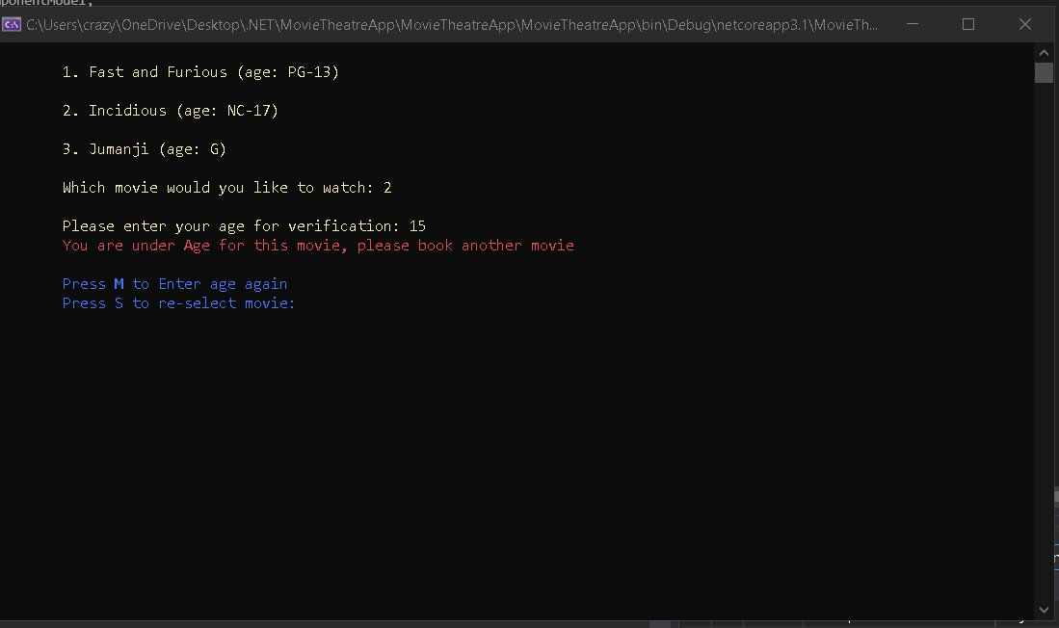

Slide 24
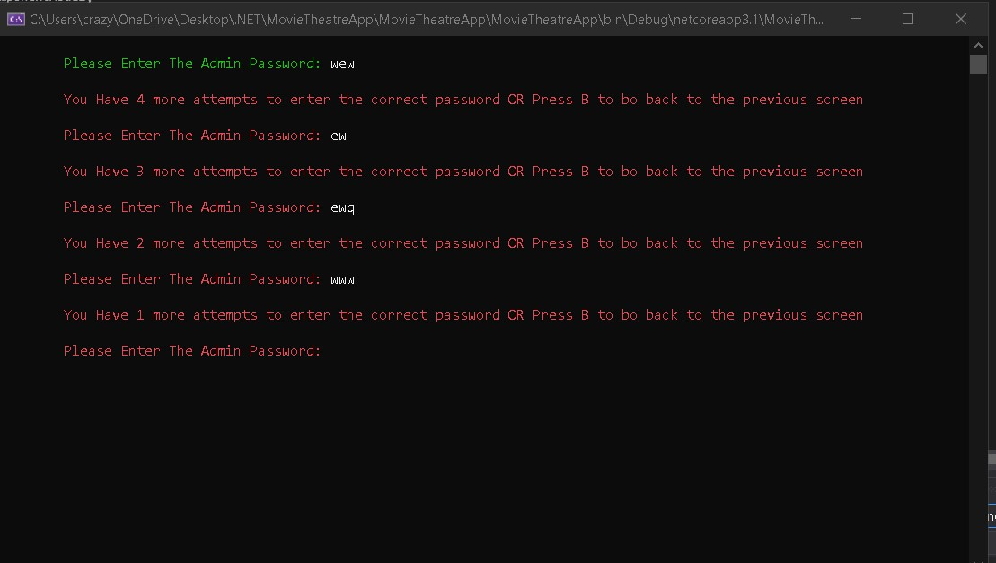

Slide 25
Thank You

